Slide 1
Travel Agency Management System
Group Members:
Manan Shah (8969)
Dev Prajapati (8964)
Rasika Virkar (8980)

Slide 2
Analysis and Design
Introduction
Problem Statement
Description of Problem Statement
Class Diagram
GUI Design

Slide 3

Introduction
The Travel Agency Management System is an Android based Application and maintains a centralized repository of all the information. The objective of this project is to develop a system which automates the processes and activities of the Travel Agency. The purpose is to design a system using which one can perform all the operations related to travelling.

Slide 4
Problem Statement
In the present system a customer has to approach various agencies to find details of places and to book tickets. This often requires a lot of time and effort and many a times customer is misguided.

Slide 5
Description of Problem Statement
The purpose of the application is to facilitate the offline customer online because customers cannot spend their precious time in markets finding the best deal.
Our priority will be customers and their requirements and also we need to develop a strong and reliable frontend which can withhold the users to our App.
We will be putting an effort to provide the right choice to the customer when they plan a holiday.

Slide 6
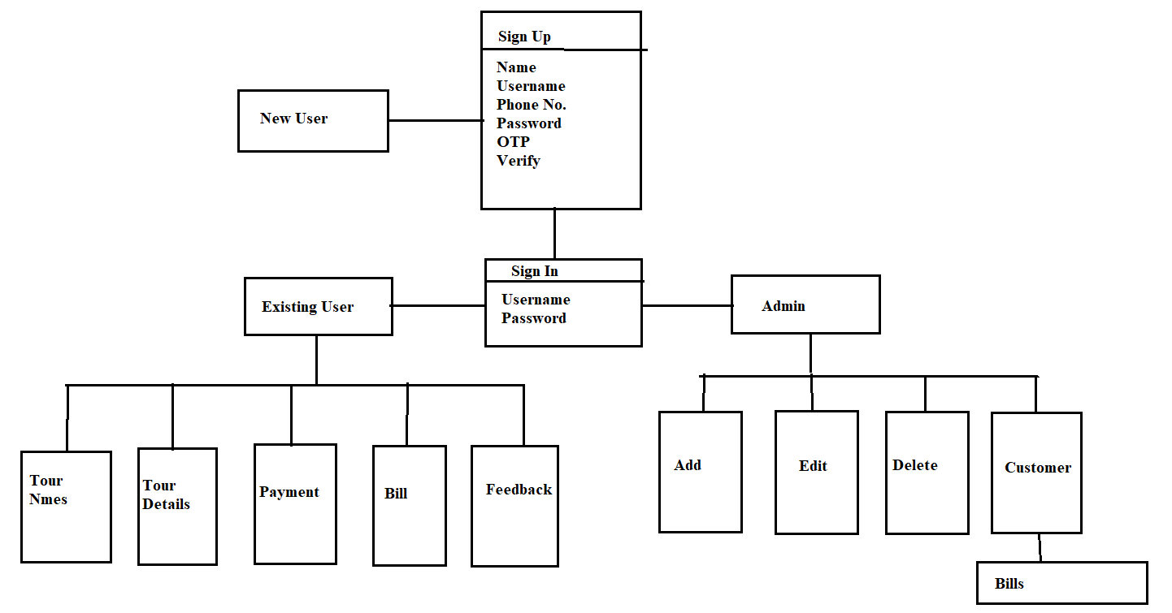
Class Diagram

Slide 7
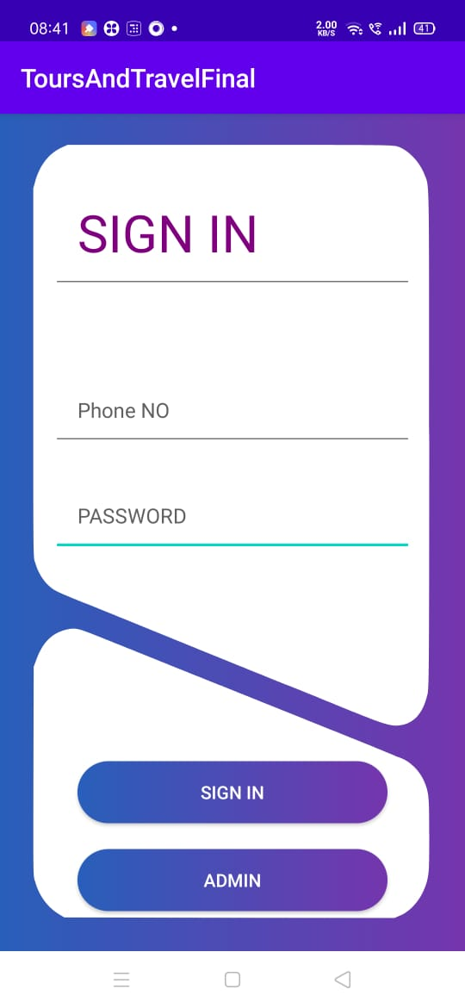
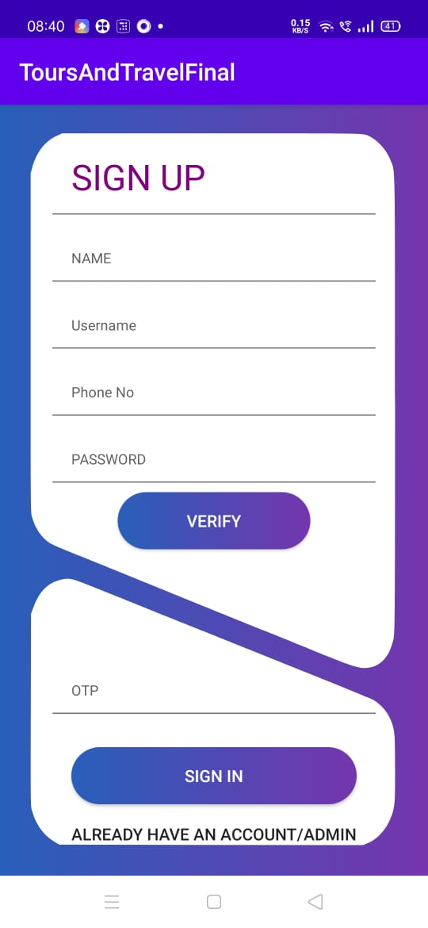
GUI Design
Sign-in Sign-Up

Slide 8
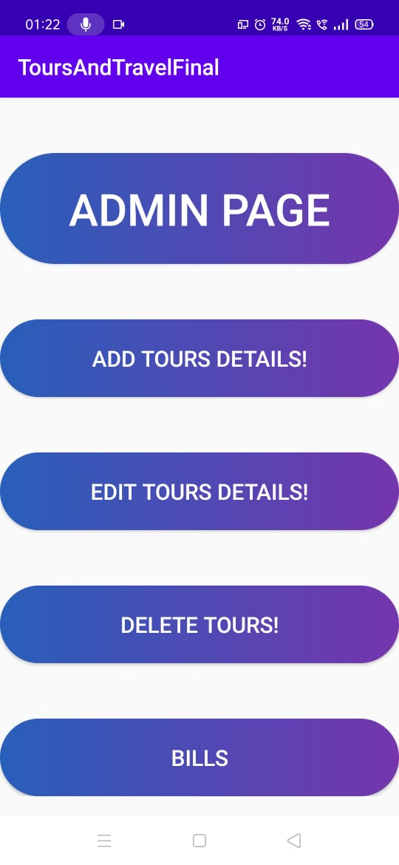
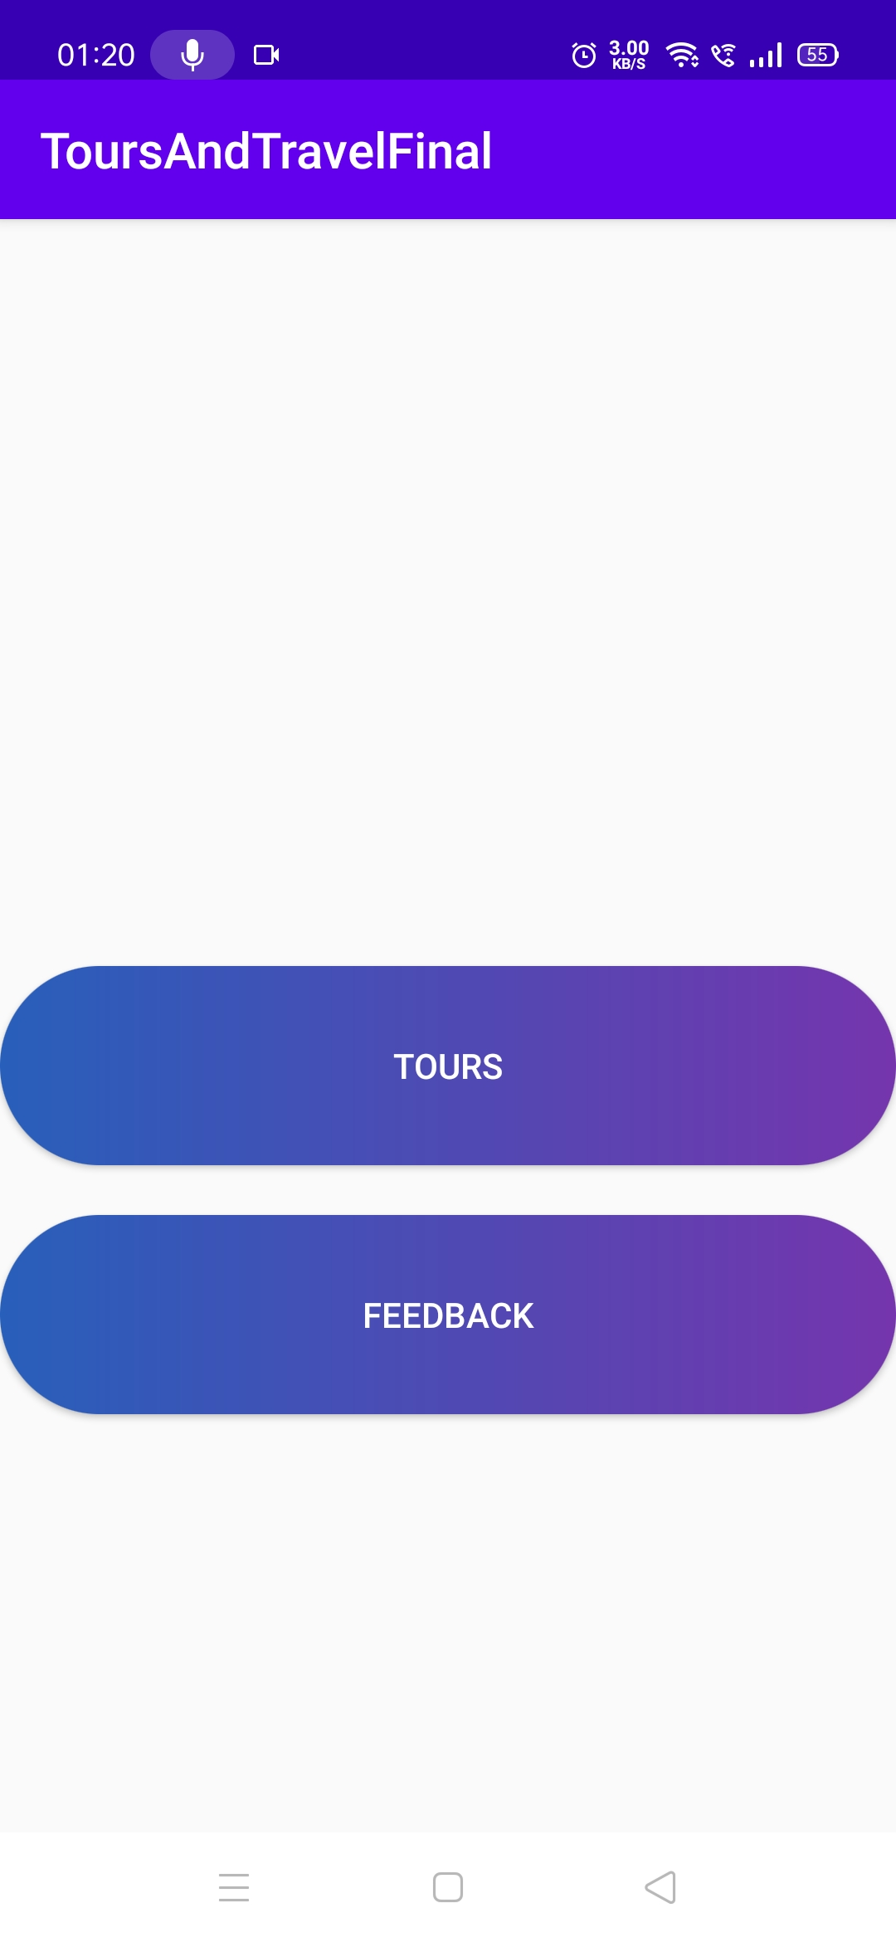
GUI Design
Admin Customer

Slide 9
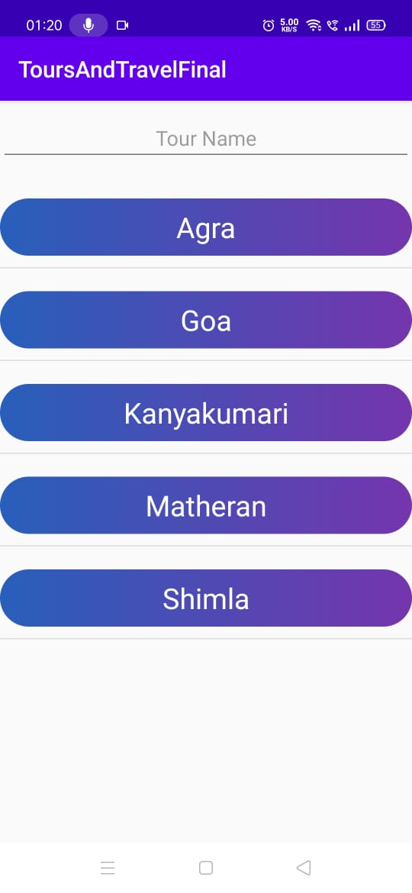
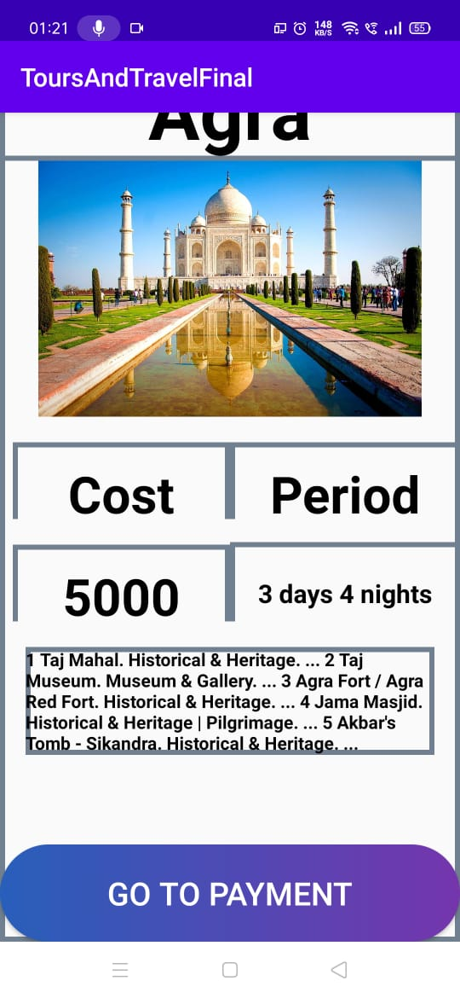
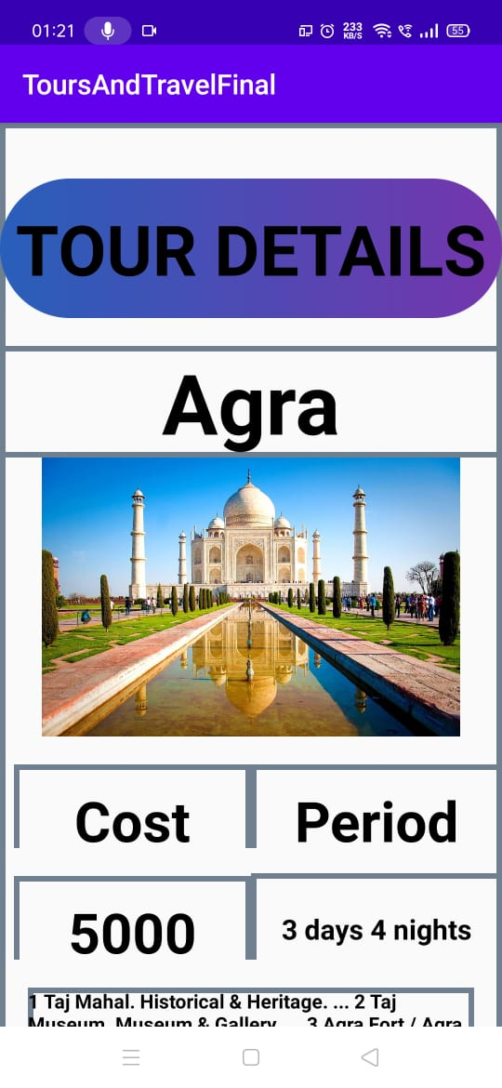
GUI Design
Tour Listview Tours Details

Slide 10
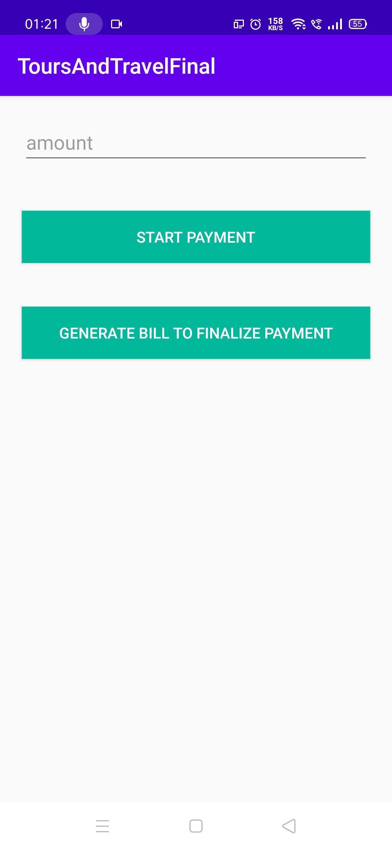
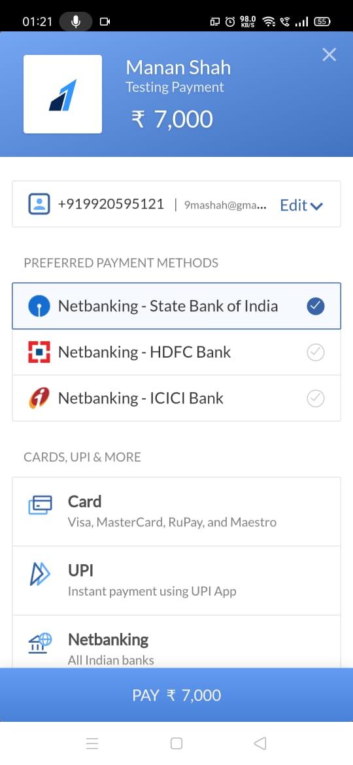
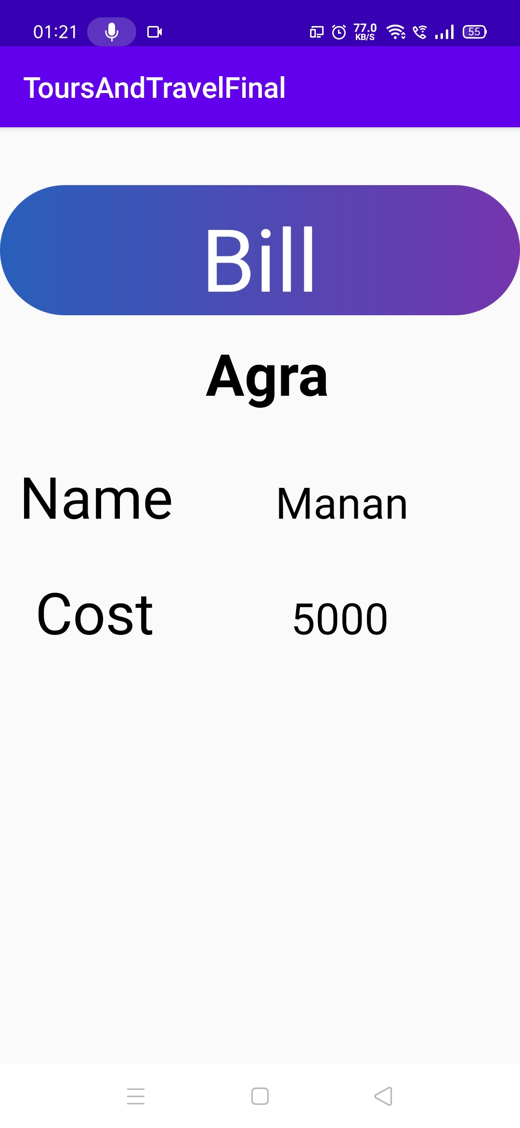
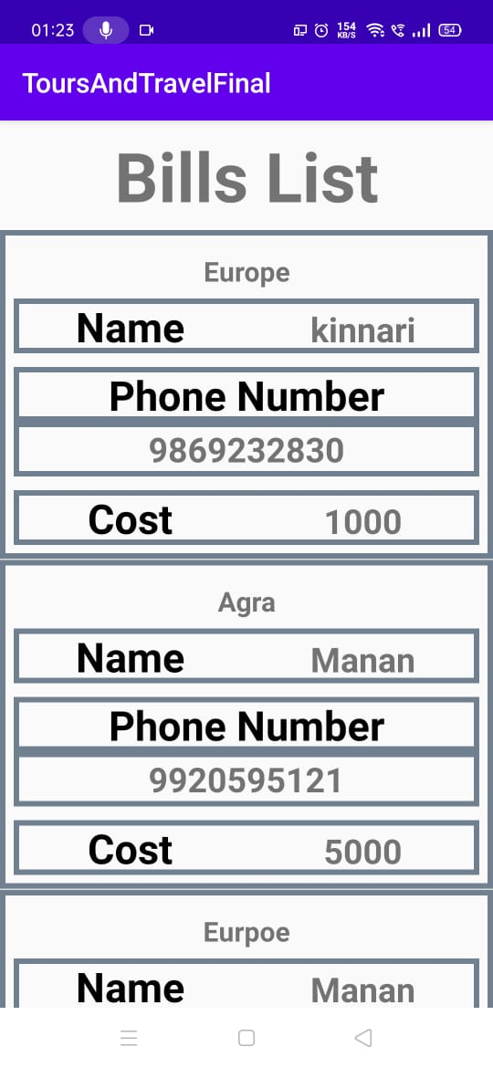
GUI Design
Payments Bills

Slide 11
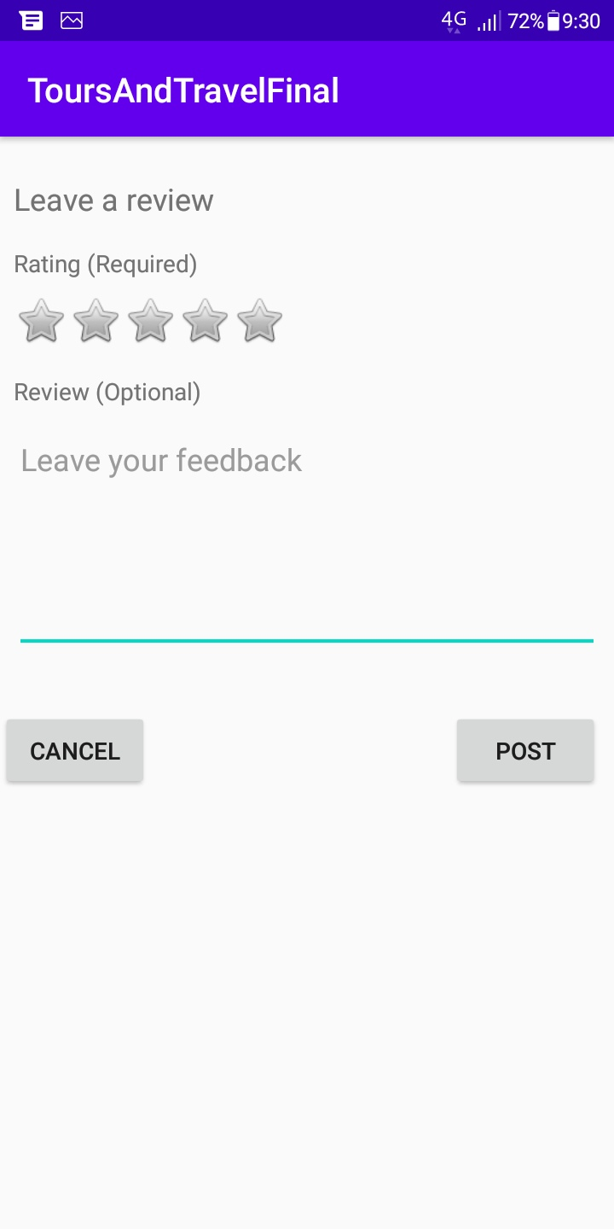
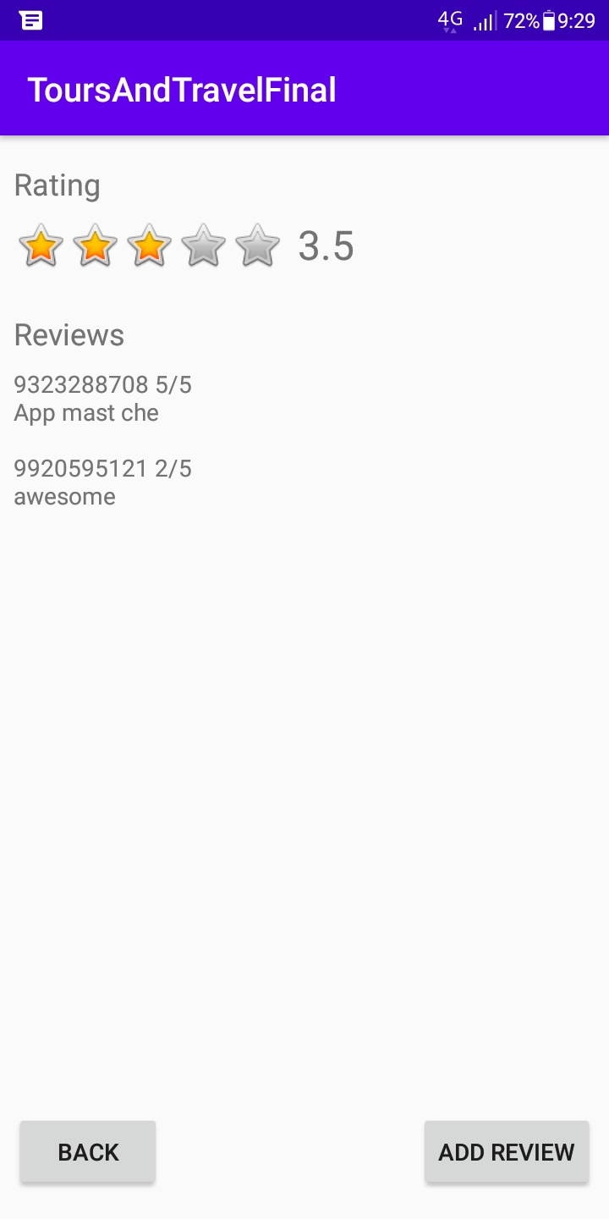
GUI Design
Adding a rating Ratings Visible to Customer

Slide 12
Implementation of Project
Admin features
Customer features
Methodology(Software and Hardware requirements)
Firebase Realtime Database
Project Extension

Slide 13




Admin Features
Add Tour
Edit Tour
Delete Tour
Customer bills
Admin can add the tour along with tour details
Admin can edit a particular tour details
Admin can delete a particular tour and its details
Admin can view all the bills of the customer

Slide 14



Customer Features
Find tours
from the list of cities
Make an Online
Payment and generate bill
Customer Feedback
(Ratings and Comments)

Slide 15
Software Requirements
Android Studio v4.1
Firebase Database linked to Android studio.
Android Emulator.
Hardware Requirements
Microsoft® Windows® 7/8/10 (64-bit).
4 GB RAM minimum, 8 GB RAM recommended.
2 GB of available disk space minimum, 4 GB Recommended.
1280 x 800 minimum screen resolution

Slide 16
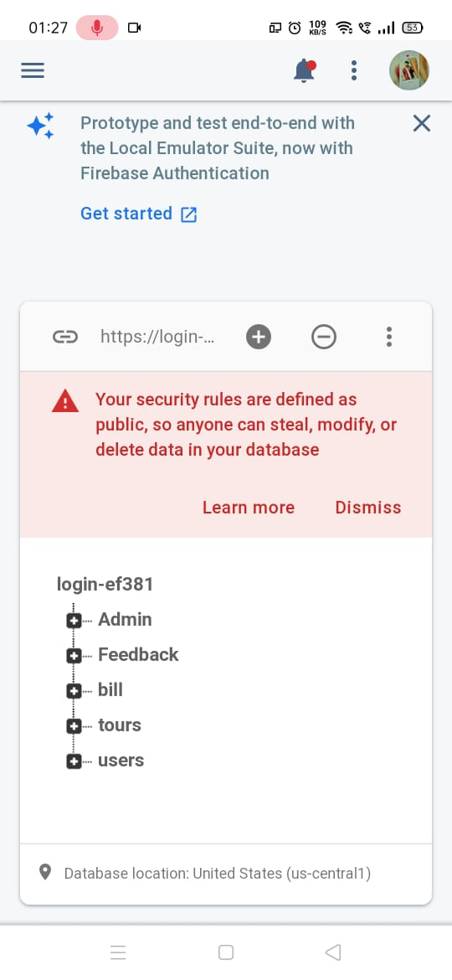
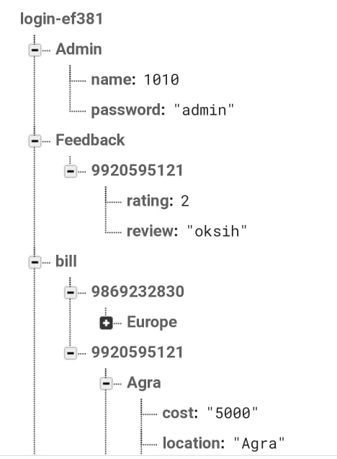
Firebase Database
Column Filters Queries

Slide 17
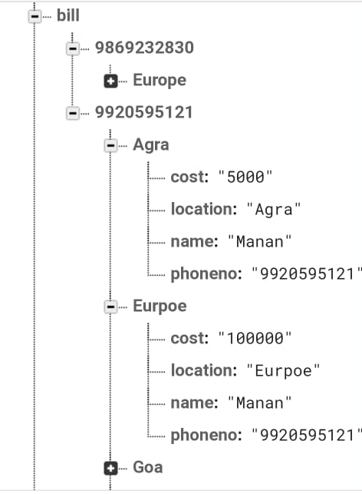
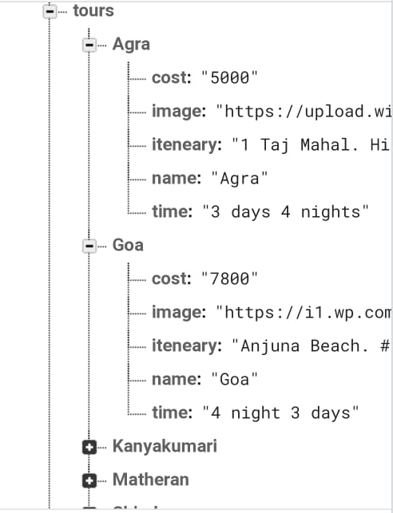
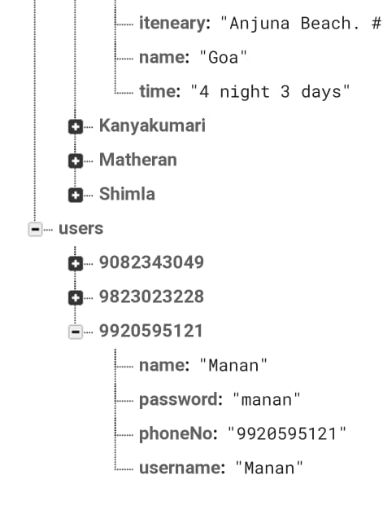
Firebase Database
Column Filters Queries

Slide 18
Project Extension
01
Adding international tours
02
Adding hotels, flights etc.
03
Social Media Integration

Slide 19
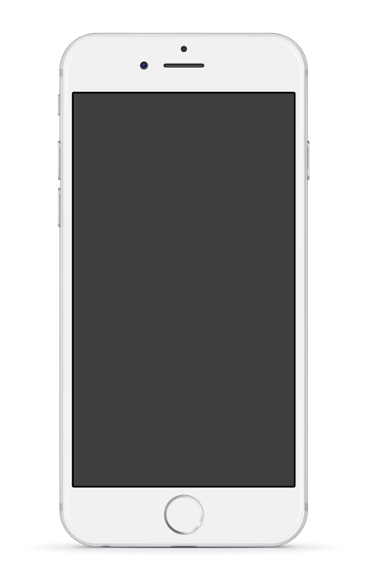
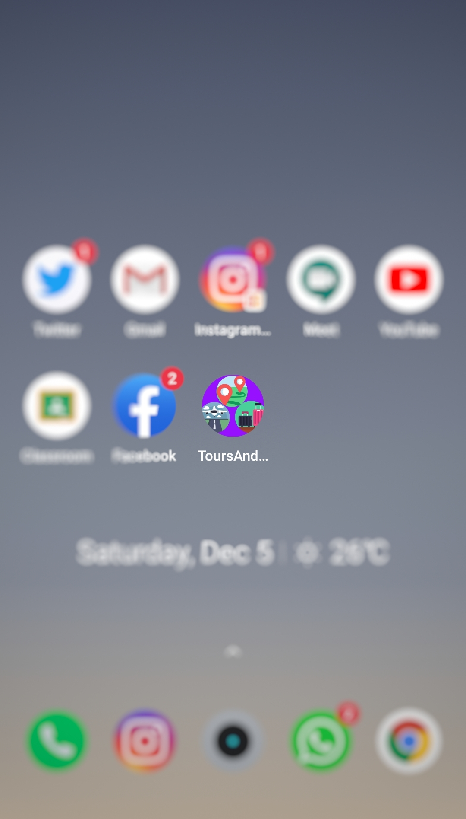

Mobile App

Slide 20
Thank You!

